Slide 1
NAVY CHILDREN SCHOOL
VISAKHAPATNAM
ORIENTATION PROGRAMME
to
Class XII
(AY 2024-25)

Slide 3
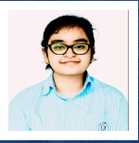
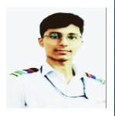
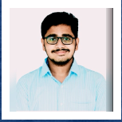
CLASS XII TOPPERS (2022-23)

Slide 4
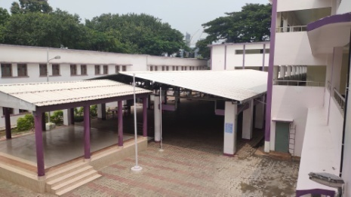
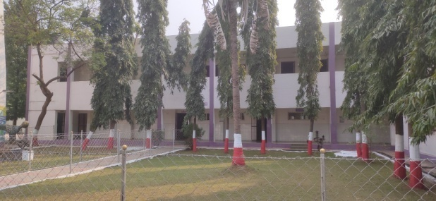
ORGANISATION CHART
PATRON FOC-IN-C
CHAIRMAN NCS
CHIEF OF STAFF
VICE CHAIRMAN NCS
CEDO
DIRECTOR NCS
PRINCIPAL NCS
DR PARUL KUMAR
VICE-PRINCIPAL NCS, NSB
MR T SATYA PRASAD

Slide 5
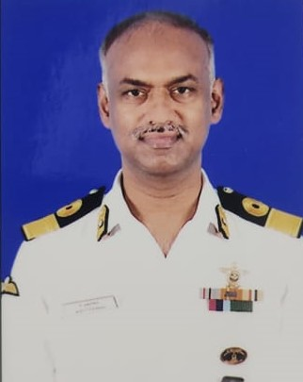
Cmde A. MUTHURAMAN
VICE-CHAIRMAN
NCS, NSB
Cdr SHALINI NAIR
DIRECTOR, NCS, NSB
Dr PARUL KUMAR
PRINCIPAL, NCS, NSB
MR T SATYA PRASAD
VICE-PRINCIPAL, NCS, NSB

Slide 6
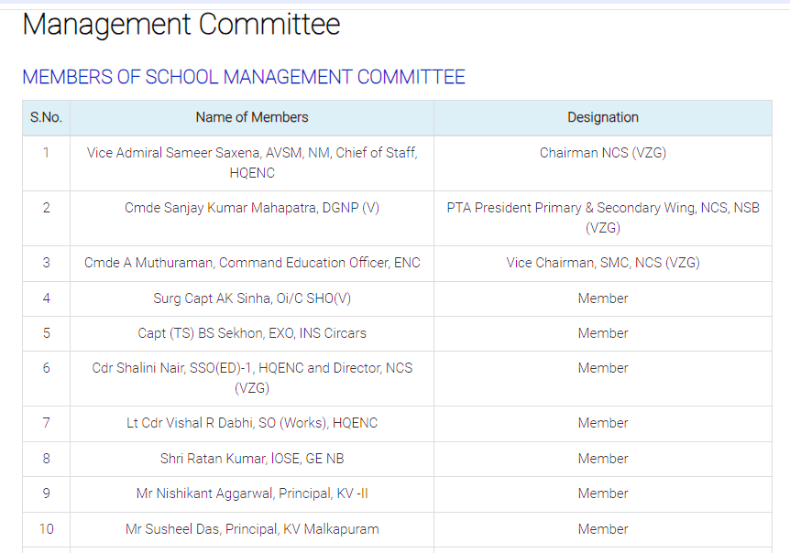

Slide 8
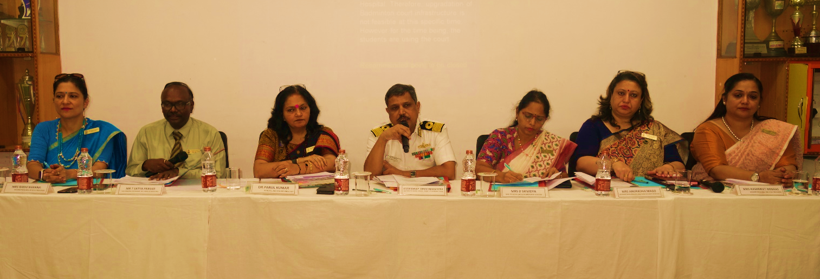
PTA MEMBERS

Slide 9
PARENT TEACHER ASSOCIATION
GBM MEMBERS (MARCH 2024)
1. | Cmde Sanjay Kumar Mahapatra Deputy Director General Planning, DGNP(V) & PTA President, NCS(V) | President
2. | Dr Parul Kumar, Principal, NCS (VZG) | Vice President
3. | Mrs D Srividya Vice Principal, NCS, 104 Area (V) | Secretary
4. | Mrs Anuradha Mago, HM, Primary, NCS, NSB(V) | Joint Secretary
5. | Mr MV Kiran Kumar PRT(Librarian), NCS, 104 Area(V) | Joint Secretary
6. | Mr T Satya Prasad Vice Principal, NCS, NSB (V) | Treasurer

Slide 10
PARENT TEACHER ASSOCIATION
GBM MEMBERS (MARCH 2024)
7. | Mrs Rakhi Khanna Headmistress, NKG, DH(V) | Treasurer
8. | Mrs Rashmeet Minhas Headmistress, NKG , NSB(V) | Treasurer
9. | Mr RVA Subramanyam, TGT(Maths), 104 Area (V) | Treasurer
10. | Mr S Raghunath | PTI member, 104 area
11. | Mrs Roumelia K Sekhon Secondary Wing , NCS NSB(V) | Teacher Member
12. | Mrs NV Jayasree Primary Wing, NCS, NSB(V) | Teacher Member
13. | Mrs Asha Kumari KG, NKG, NSB(V) | Teacher Member
14. | Mrs K Kirti Sundari KG, NKG, DH(V) | Teacher Member
15. | Mrs Sarita Kumari TGT SST, 104 Area (V) | Teacher Member

Slide 11
NES MOTTO
“GYANEN SHOBHATE” i.e.,
“Knowledge is Bliss”
This motto serves as a constant reminder to the students and teachers of NCS that knowledge is bliss and quest for knowledge will motivate them to strive for more and more knowledge.

Slide 12
NES VISION
To transform all Navy Children Schools into branded schools of international standards providing world class education.

Slide 13
NES MISSION
To nurture the students to be life-long learners, instilled with sound moral values, who are respectful and responsible and who rise to the challenges of life creatively and enthusiastically, in an ever-changing world.

Slide 14
INSTITUTIONAL
PLAN

Slide 15
SQAAF
NEP

Slide 16
ACADEMICS
FUTURE READINESS
CO-CURRICULAR ACTIVITIES
COMMUNITY OUTREACH
INSTITUTIONAL PLAN
LIFE SKILLS
INCLUSIVE EDUCATION
SPORTS
HEALTH & WELLNESS

Slide 17
INCLUSIVE
EDUCATION

Slide 18
LEARNING CENTER
INDIVIDUALISED EDUCATION PLAN (IEP)
INCLUSIVE EDUCATION
MULTI DISCIPLINARY TEAM
PARENTAL INVOLVEMENT
PANEL
BUDDIES FOR CWSN

Slide 19
ACADEMIC COMMITTEE
PRINCIPAL
VICE-PRINCIPAL
ACADEMIC
CO-ORDINATOR -1
ACADEMIC
CO-ORDINATOR -2
CLASS
CO-ORDINATOR
CLASS TEACHERS
SUBJECT TEACHERS

Slide 20
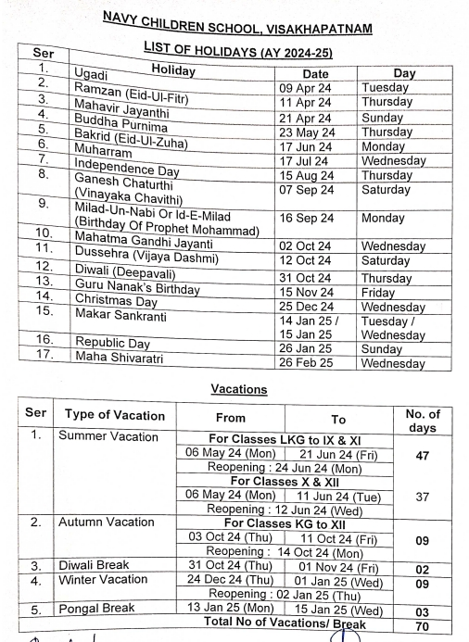

Slide 21
XII COORDINATOR
(AY: 2024-25)
Mrs.D. Bhanumati
PGT (Chemistry)

Slide 22
INTRODUCTION OF
CLASS TEACHERS
XII A (Science) Mrs D Bhanumati
XII B (Science) Mr Venu Gopal
XII C (Science) Mrs V S Eswari
XII D (Commerce) Mrs Ragini Mishra
XII E (Humanities) Mrs Farida Parveen

Slide 23
INTRODUCTION OF SUBJECT TEACHERS
(Science Stream : XII A)
Subject | Name of the Teacher
English | Mrs Jyoti Rani
Physics | Mrs V S Eshwari
Chemistry | Mrs D Bhanumati
Mathematics | Mrs Ahalya
Mathematics | Mr Venu Gopal
Computer Science | Mr Mukesh Bohra
Physical Education | Mr V R Prasad
Economics | Mrs Ragini Mishra

Slide 24
INTRODUCTION OF SUBJECT TEACHERS
(Science Stream : XII B)
Subject | Name of the Teacher
English | Mrs Jyoti Rani
Physics | Mrs V S Eshwari
Chemistry | Mrs D Bhanumati
Mathematics | Mr Venu Gopal
Computer Science | Mr Mukesh Bohra

Slide 25
INTRODUCTION OF SUBJECT TEACHERS
(Science Stream : XII C)
Subject | Name of the Teacher
English | Mrs V Gauri
Physics | Mrs V S Eswari
Chemistry | Ms P Vijaya Lakshmi
Mathematics | Mrs Ahalya
Biology | Mr A Srinivasa Rao
Physical Education | Mr V R Prasad
Psychology | Ms Swati

Slide 26
INTRODUCTION OF SUBJECT TEACHERS
(Commerce Stream : XII D)
Subject | Name of the Teacher
English | Mrs V Gauri
Accountancy | Mr N. Mouli
Economics | Mrs Ragini Mishra
Informatics Practices | Mr S. Raju
Physical Education | Mr V R Prasad
Mathematics | Mr Venu Gopal
Applied Mathematics | Mrs Ahalya
Business Studies | Mrs Rukhsana

Slide 27
INTRODUCTION OF SUBJECT TEACHERS
(Humanities Stream : XII E)
Subject | Name of the Teacher
English | Mrs V Gauri
Psychology | Ms Swati
Political Science | Mrs Farida Parveen
History | Mrs Farida Parveen
Economics | Mrs Ragini Mishra
Physical Education | Mr V R Prasad
Mathematics | Mr Venu Gopal
Geography | Mrs K Shiny
Hindi | Dr Nirmala

Slide 28
SCHOLASTIC AREAS
Marks and Grades both will be
awarded for Individual subjects.
8-Point grading will be followed by
the board. (A1, A2, B1, B2, C1,
C2, D & E(Needs Improvement)

Slide 29
CO-SCHOLASTIC AREAS
These activities will be graded on a 5 - Point Grading Scale (A to E) and will have no descriptive indicators. No up-scaling of grades will be done.
The co-scholastic areas are as follows:
Work Education/ SEWA – Awarded by the concerned
teachers
Art Education – Awarded by the concerned
teachers

Slide 30
CO-SCHOLASTIC AREAS
Health & physical Education – Awarded by
the Physical Education teacher.
Discipline – Awarded by class teachers & the concerned subject teachers based on their values, attendance, behaviour and attitude towards teacher & peers.

Slide 31
INTRODUCTION OF CO-SCHOLASTIC TEACHERS
(All Streams) - NSB
Subject | Name of the Teacher
Work Experience/ SEWA | Mr Mukesh Bohra Mr S Raju
Yoga | Dr Satya Vani
Health & Physical Education | Mr V R Prasad
General Studies | Mr Satya prasad

Slide 32
MIME
SINGING
CRAFTS
DEBATES
DANCE
CO-CURRICULAR
ACTIVITIES
YOGA
QUIZ
COOKING
INSTRUMENTAL MUSIC
PANEL DISCUSSION

Slide 33
CO-CURRICULAR ACTIVITIES
HOUSES:
The School has a House System with the aim of fostering team spirit and healthy competition among students. The students are divided into four houses-
Dunagiri, Himgiri, Nilgiri and Udaygiri in Secondary Wing, NSB, Visakhapatnam.
Each House is headed by a Captain, a Vice-captain and two Prefects. A member of the teaching staff acts as the House Teacher-in-charge.

Slide 34
2. Houses for the new admissions will be allotted by the
class teacher.
The Competitions are held house wise. A student will be allowed to take part in only 3 House Competitions . (Individual and Group together)
4. List of Competitions class-wise is available in the
e-almanac.

Slide 35
MAJOR FUNCTIONS
INVESTITURE CEREMONY
SPORTS DAY / ANNUAL DAY
CORNUCOPIA
ANNUAL PRIZE DISTRIBUTION

Slide 36
CO-CURRICULAR ACTIVITIES
CLUBS:
To encourage informal and independent learning, the school started a number of clubs.
The school organises the club activities for classes VI-VIII on the working Saturdays
(first and fifth Saturdays).
Club display “CORNUCOPIA” will be organised
on 14-11-2024.
Note: No change in the allotted class and section, House
and Club will be entertained.

Slide 37
BUS - DISCIPLINE
Students need to board the bus by
following proper line
Should not leave the bus after boarding for
the sake of meeting friends or for
purchasing food items from canteen.
Should not create noise in the bus and must maintain silence always.
Disciplinary Action will be taken on the student whomsoever violates the rules

Slide 38
DISCIPLINE
The students are instructed not to indulge in any of the following. If they do so, their names will be entered in the Register of Indiscipline & this will be informed to the parents on regular basis.
As per the NES guidebook, the following acts & conduct of students will amount to misconduct :
Misbehaviour towards teacher or any
other employee of the school.
Intentional disturbance of the class.

Slide 39
DISCIPLINE
3. Continued absence from school without
permission of the teacher /Principal.
Leaving the school premises or playground during school hours without prior permission of the concerned teacher /Principal.
Bullying , foul language / intimidation of
others.
Eve teasing/Adam teasing –misbehaviour towards girl/boy.
7. Damage / theft /disfiguring of school property.

Slide 40
DISCIPLINE
08. Disobeying orders of the teacher / principal.
09. Involving in acts of moral turpitude.
Smoking / use of drugs / consumption of
alcohol/ any form of gambling.
11. Use of violence in any form.
12. Casteism / practice of untouchability
Improper use of computer resources of the
school amounting to display or access of
unauthorised websites / software portraying
indecent / pornographic material.
14. Unfair means during examinations.
15. Habitual late coming to school.
16. Missing classes (bunking) during school hours.
17. Bringing unauthorised articles inside the school.(sharp objects, smart watch, mobiles, camera, Bluetooth or any other electronic gadgets)

Slide 41
PLAN OF ACTION FOR INDISCIPLINE
As per the NES guidebook
I Offence : Parent is informed, warning letter is issued.
II Offence : 2nd Warning letter is issued with emphasis on suspension for next offence.
III Offence : suspension for 1 day / 2 days / 3 days depending on the severity of the deed.
In some cases immediate expulsion from school can be initiated by the school authority.
Unfair means : Zero is allotted in that particular subject along with a warning letter. No retest is conducted.
Unauthorised articles confiscated will be retained by the school principal and warning letter is issued.

Slide 42
ADVISORY TO PARENTS
Students are very active on social media such as
WhatsApp groups, Instagram, Face book, Twitter, Snapchat etc.
Monitor your child strictly for the same . All networking sites / platforms allow users aged 13 & above but the risk factor is high without parental consent / guidance .

Slide 43
ATTENDANCE
75% attendance is mandatory for appearing in the CBSE Board Examination.

Slide 44
SCHOOL TIMINGS
07:40 hrs – 1350 hrs
School gate will close after the second bell rings at 7:40 a.m.
BREAK TIMINGS
I Break : 1000 – 1015 hrs
II Break : 1210 – 1220 hrs

Slide 45
GENERAL INSTRUCTIONS
FOR GIRLS:
Hair below shoulder level should be neatly
plaited into two for I to XII classes.
Length of the skirt should be below knee level.
Nails should be trimmed.
Nailpolish and Mehendi is not allowed.
FOR BOYS :
Proper Hair cut. Trimmed nails and Beard
for I to XII classes.

Slide 46
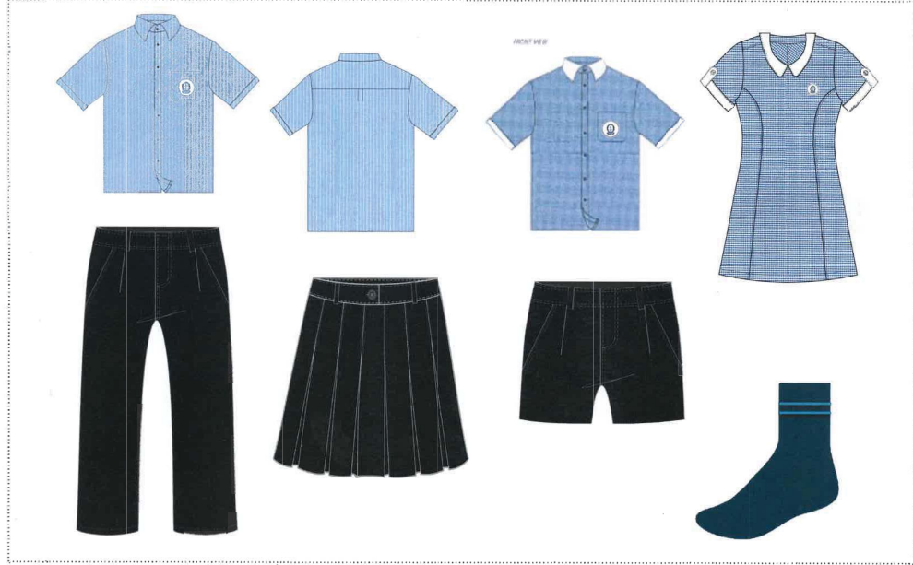
SCHOOL UNIFORM
BOYS / GIRLS PRIMARY & SECONDARY

Slide 47
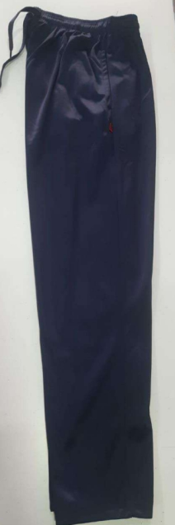
SCHOOL UNIFORM
BOYS / GIRLS PRIMARY & SECONDARY(SPORTS)
The blue track pants will be available in school Premises of NCS, NSB Secondary wing

Slide 48
SCHOOL UNIFORM
The track pants will be available in school
Premises of NCS, NSB Secondary wing
It can also be procured through online
https://www.hirawatsonline.com/collections/all
The track pants can be bought directly from
Hirawats outlet (Address – Hirawat fashions
Dabagardens, Visakhapatnam)

Slide 49
SCHOOL UNIFORM

Slide 50
BOOK SALE
List of Books for all classes has been uploaded in school website for parents reference.
For Door delivery WhatsApp Gupta Brother (Mob No. 9346625493)
For any other queries contact Ms. Aparna (Mob: 9949390257) and Ms Begum (Mob: 9642713297)

Slide 51
IMPLEMENTATION OF NEP
Teachers Training
Competency Based Learning
Skill Based Subjects
Experiential Learning
Foundational Literacy and Numeracy

Slide 52
SEWA
LIFE SKILLS
SHRAMDAAN
VALUES
DISCIPLINE
SELF
AWARENESS

Slide 53
CRICKET
HANDBALL
BADMINTON
KARATE / TAEKWONDO
ATHLETICS
FOOTBALL
KABADDI
SPORTS
BASKETBALL
TABLE TENNIS
SWIMMING

Slide 54
PHYSICAL
HEALTH & WELLNESS
SOCIAL
MENTAL
ENVIRONMENTAL
EMOTIONAL

Slide 55
FLASH MOB
COMMUNITY OUTREACH
RALLIES
STREET PLAY
NIOS
PRABHAT PHERI
DEMONSTRATIONS

Slide 56
IMPLEMENTATION OF NEP
SQAAF
(SCHOOL QUALITY ASSESSMENT AND ASSURANCE FRAMEWORK)
FUTURE READINESS
POSH
SSB MENTORING
FIRST AID MANUAL
REGULAR EVACUATION DRILLS
SOPS

Slide 57
DIARY
Diary is the primary means of communication between the school and the parent. Diary should be brought to school every day.
ILLNESS
Please do not send a child to school, if unwell.

Slide 58
PARENT TEACHER INTERACTION
PTI meetings will be conducted
according to school almanac after every examination.
Irrespective of the above, parents can meet teachers on any working Wednesday (1400 hrs – 1500 hrs) with prior intimation to the teacher.

Slide 59
LEAVE
School Principal permission is needed
For more than
two days leave.

Slide 60
SCHOOL CALENDAR
Will be shared with parents soon.
ENTAB
User ID & Password of parents for logging into ENTAB will be provided by school for the new admissions. All communication will be done through ERP only. WhatsApp be discontinued w.e.f 1st April 2024. School fee to be paid Quaterly through School ERP only.

Slide 62
NOTE
In case of any change in the Address or Contact Number you are requested to inform
the school

Slide 63
ACTIVITIES BY COUNSELLOR
April - General orientation on planning , organizing & implementation of effective study habits (classes VI-XII )
July - Imparting life skills (classes VI-XII)
September – Handling anxiety during exams / tips to perform well in exams

Slide 64
MONTHLY
FORECAST
Monthly forecast will be shared with the parents in the beginning of the month with details of academic plan, bridge course, Sports activities & CCA activities.

Slide 65
Remedial classes will be conducted for low performing students by the subject teachers in school hours

Slide 66
PROJECT CONNECT
Under project connect a team of compassionate teachers and counsellor work on anxiety and emotional issues of students. Peer tutoring is also encouraged.

Slide 67
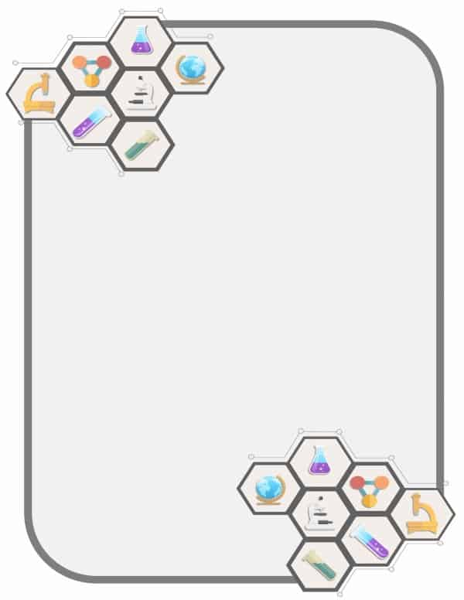
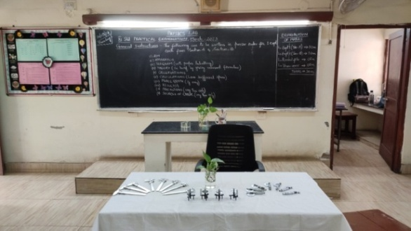
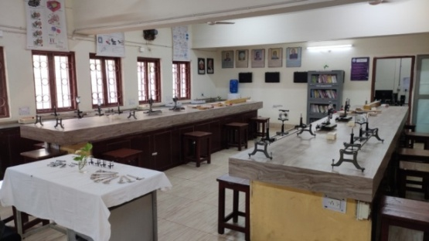
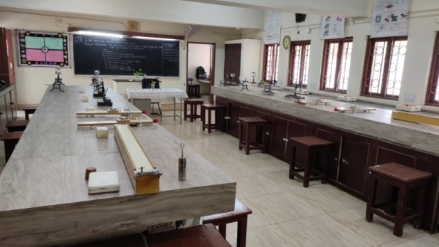
PHYSICS LAB

Slide 68
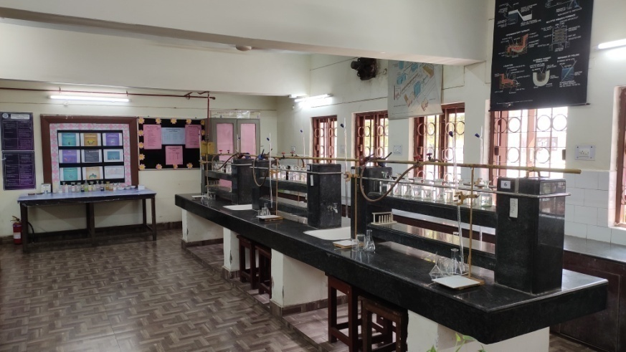
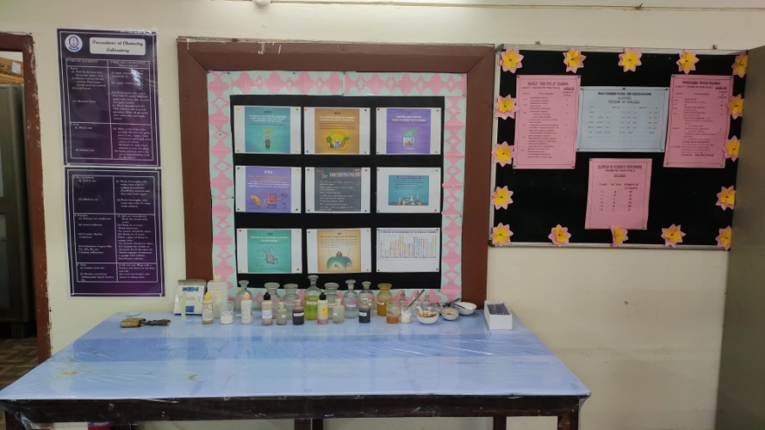
CHEMISTRY
LAB

Slide 69
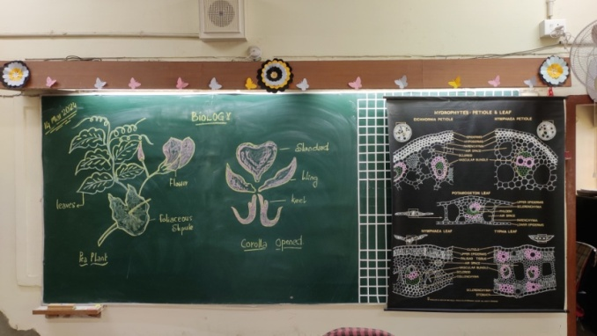
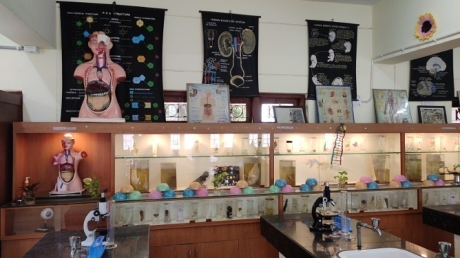
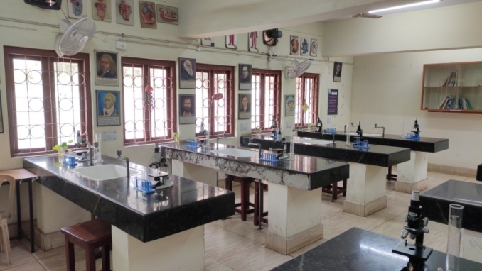
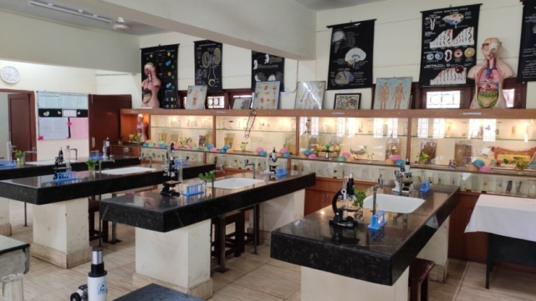
BIOLOGY LAB

Slide 70
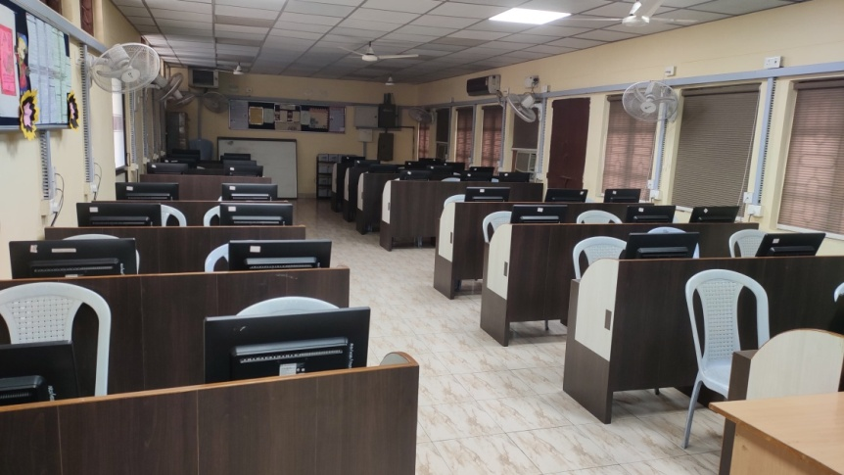
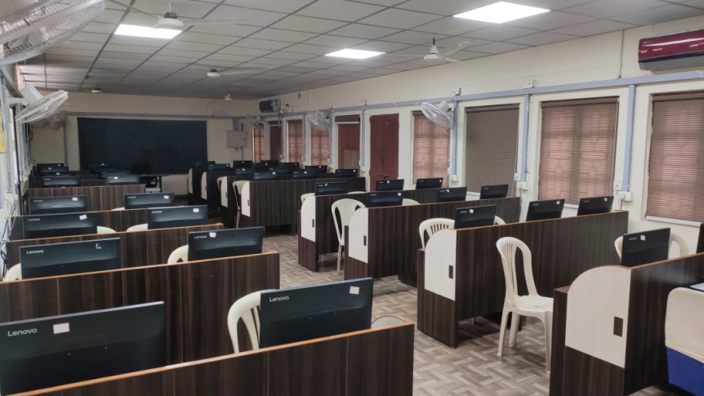
COMPUTER LAB
This Photo by Unknown Author is licensed under CC BY-NC

Slide 71
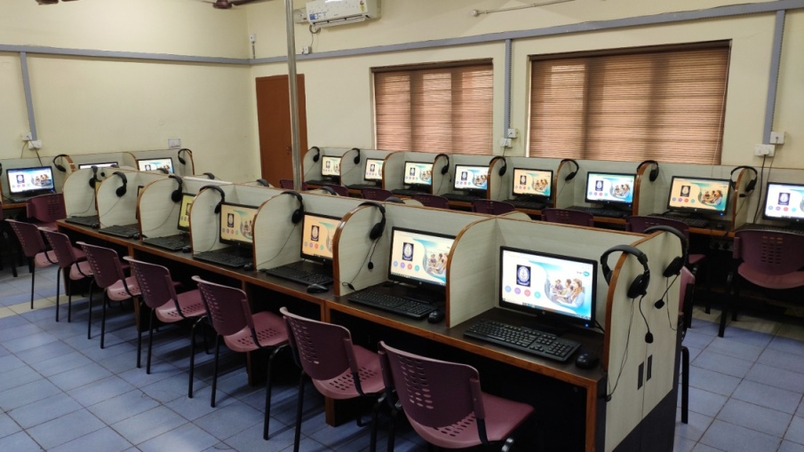
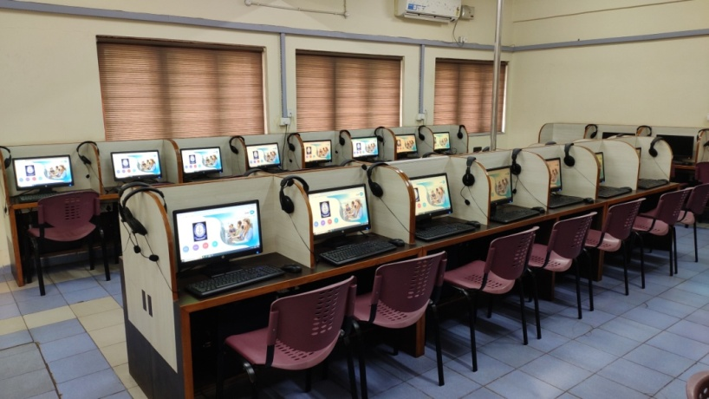
LANGUAGE LAB

Slide 72
GRIEVANCES
Grievances need to be
addressed to Class teacher

Slide 73
FEEDBACK
Regular feedback through Google form will be collected from parents.

Slide 74
THANK YOU

